Slide 1
UME Administrative Monday
August 23, 2021

Slide 2
Agenda:
Jim Hanson - Associate Dean and Associate Director Update
Aly Valentine – Operations Update
Jeff Howard – Program and Organizational Development Update
Nia Fields – 4H Update
Jinhee Kim – FCS Update

Slide 3
AD Report
Telework is aligned with the Dean’s message
1-day per week, any day
Office plan will be coordinated with the unit supervisor and then sent to my office
Full telework agreements need to be completed
Six months agreements and then re-evaluated
Two-days per week need to be approved by Dean’s office

Slide 4
AD Report
Unvaccinated Employees
Are required to wear a mask indoors at all times and while outdoors in crowded spaces.
Are required to sign a memorandum acknowledging the health risks of being unvaccinated.
Are required to comply with regular, twice-a-week on-campus COVID-19 testing.
Local testing is okay;
Administrative leave is available
Travel reimbursement for those who are compliant and have an exemption

Slide 5
AD Report
Vaccinated Employees
Local standards for masking
Optimize Urban Environments
An AGNR Cornerstone Event, November 11 & 12
October 13, 2017

Slide 6
Operations Updates
Title is Arial (Body) 20 pt
Body is not italized at Arial 18 pt – bullets are dark red

Slide 7
Program and Organizational Development Updates
Positions to support new Unit – Data Management and Director of Evaluation and Assessment
Fall training plan for program planning
Extension Academy for new Faculty! Multi state collaboration
Publications: 8 new published items since June and call for focus group
DEIR UME: 1st meeting 8/24 – Group enhanced with: Dhruti Patel, Lee Schnappinger Bridgman, Janet Sefton

Slide 8
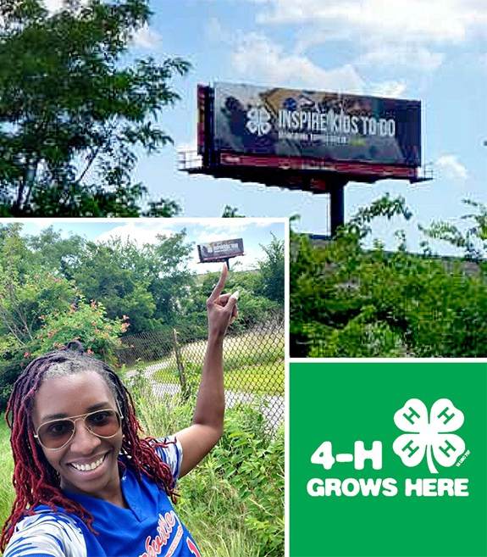
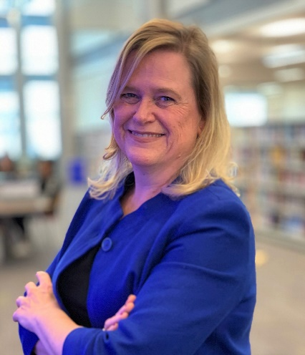
4-H Updates
Welcome to Rose Greene Colby, Executive Director & Holly Finneran, Business Svs. Mgr.

Slide 9
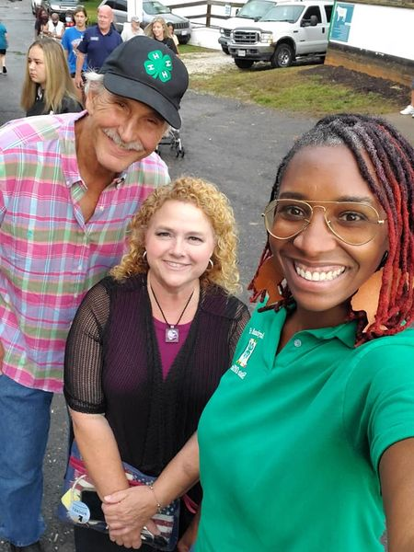
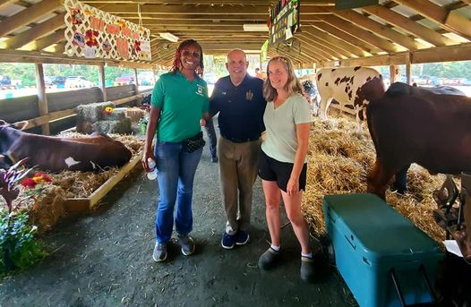
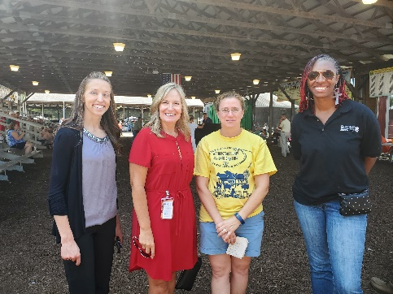
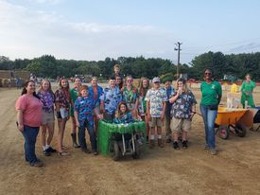
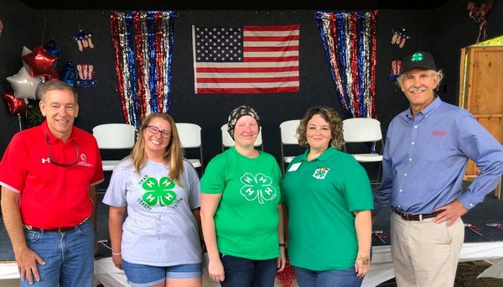
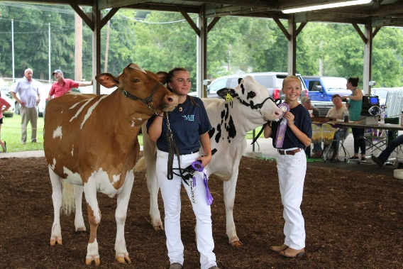
4-H Updates- Fair Season

Slide 10
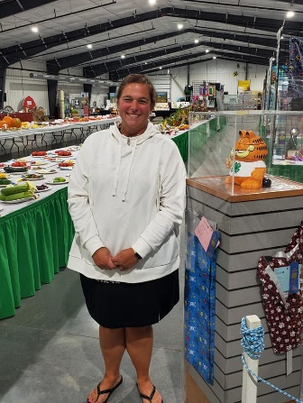
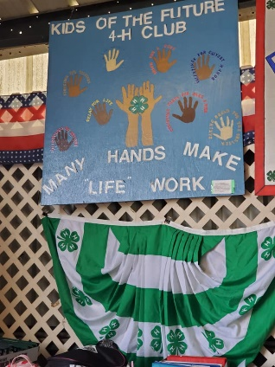
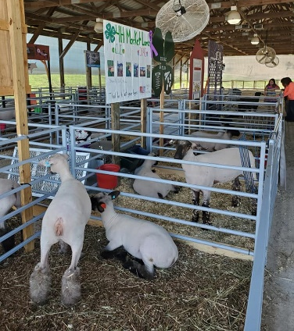
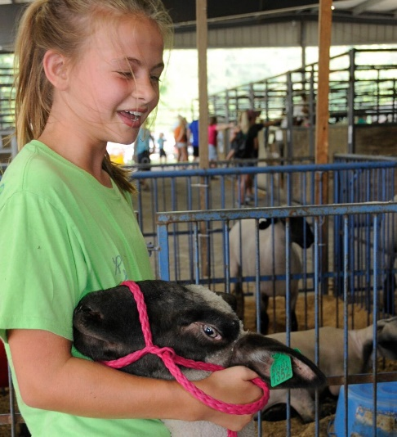
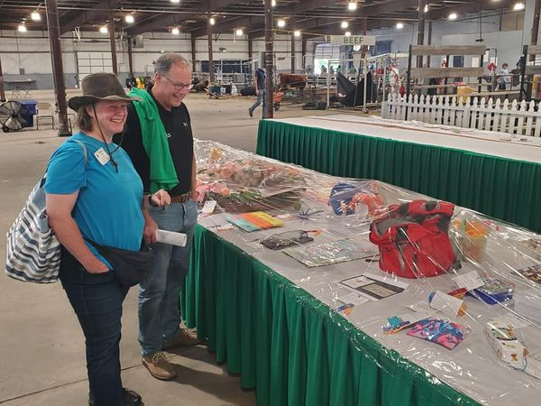
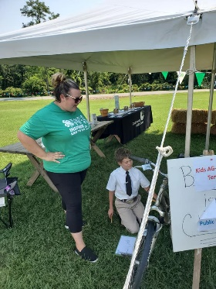
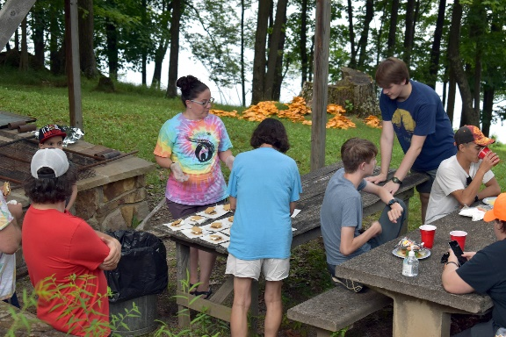
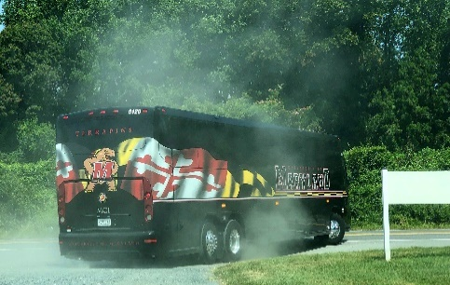
4-H Updates- Fairs & Camps

Slide 11
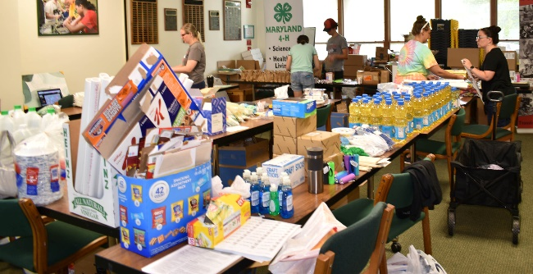
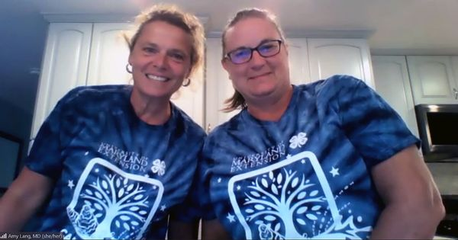
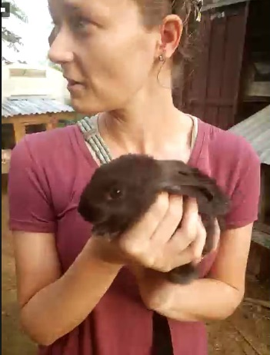
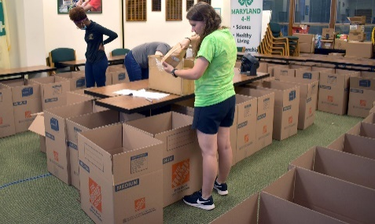
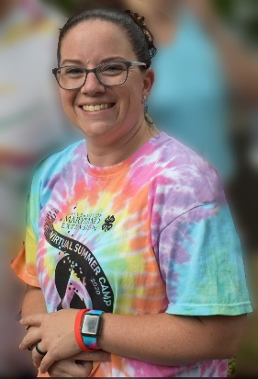
4-H Updates- 4-H Virtual Camp
A virtual visit to Tanzania

Slide 12
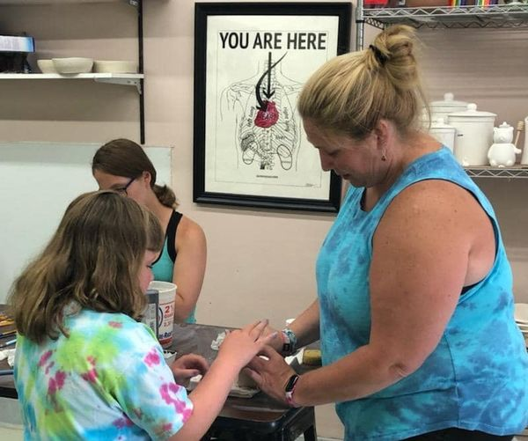
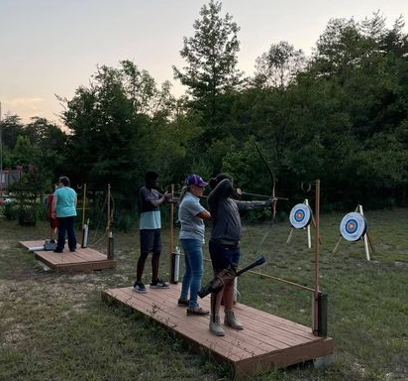
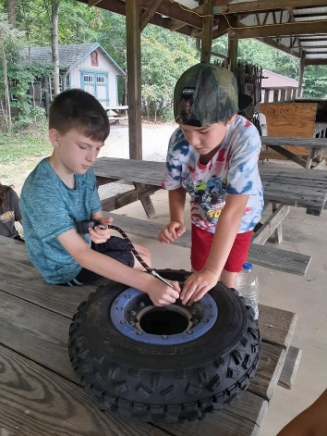
4-H Updates- 4-H Summer Programs
Archery
Mudslingers Workshops
Ag Innovators Experience
ATVs, Dirt Bikes and 4-H Safety

Slide 13
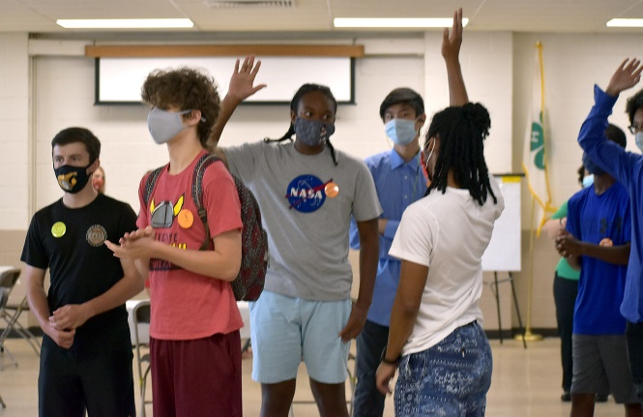
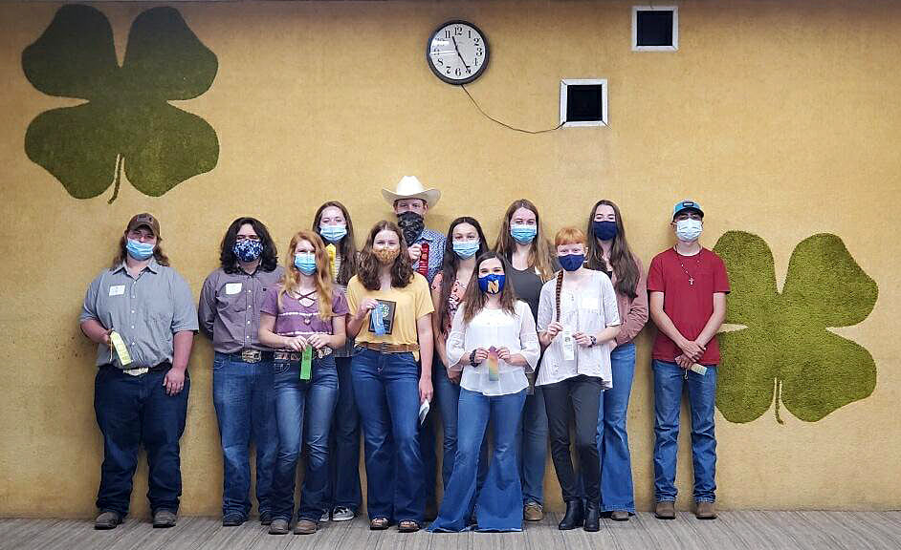
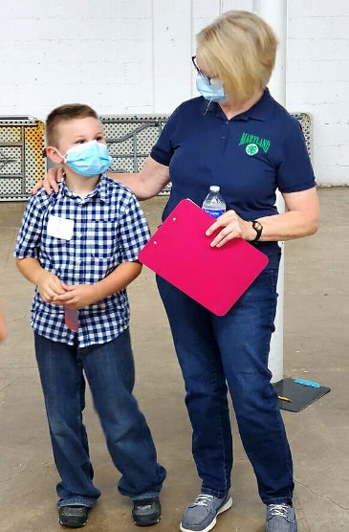
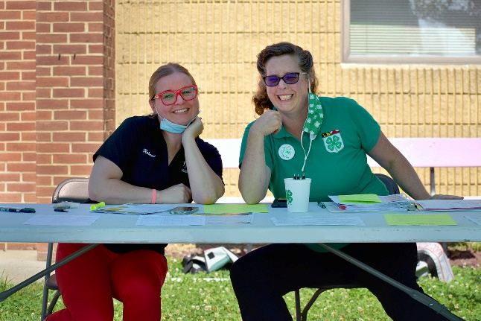
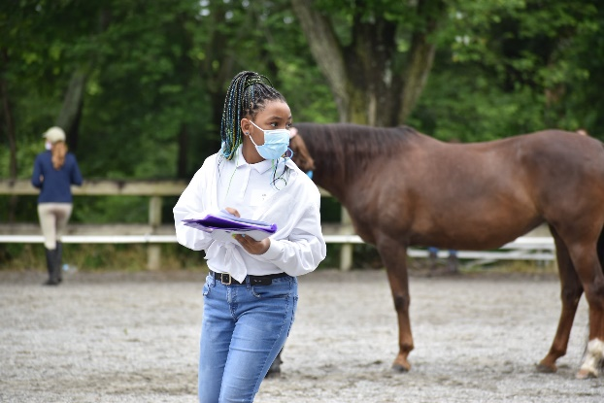
4-H Updates- 4-H Leadership Summit & Contests

Slide 14
4-H Updates- Fall Retreat
October 27th- virtual w/ optional late afternoon social gathering (TBD)
October 28th- State leader updates, program planning, hot topics & networking (in-person TBD)

Slide 15
FCS Updates
DASH-Plus 2021
Eight Weekly Virtual Sessions
Adults 55+ with high blood pressure
Group 1: Western Region/Northern Cluster/Central
Tuesdays in August September
Group 2: Central/Capital
Every Tuesdays in July & August
Group 3 Southern/Lower, Mid, Upper Eastern Shore
Thursdays September and October
Notes:
Eight Sessions on
Introduction to DASH Plus
Sodium
Grains
Dairy
Fruits and Vegetables
Shopping and Budgeting
Meats and Other Protein
Fats and Sweets

Slide 16
FCS Updates
MSDE Child Adult Care Food Program
August-September 100 childcare providers. There are four online modules on CANVAS:
Key nutrition strategies of the CACFP
Whole grain-rich foods: Why they are important, and how to include in menus
Planning healthy, balanced, and appealing meals and snacks
Building cycle menus & incorporating multicultural recipes

Slide 17
FCS Updates
Fresh Conversations
32 centers during September 2021 - April 2022
Direct Education
4-8 sessions in senior Centers
Train the Trainer Education
Area Agency on Aging Team
Volunteer Training in September
Notes:
Direct education:
32 tickets were purchased (meaning 32 centers)
Mona, Karen, Erin, Shauna, Cheryl, Beverly, Dhruti, Terry, and who ever takes Jeanette's classes (9 people)
TTT education:
12 tickets were purchased (meaning 12 centers).
Planning: Mona, Shauna, and Tami are planning for training. Cheryl will attend the training for one hour to teach a session a class so the volunteers will learn.
Implementation: AAAs or their volunteers will be teaching the class.
Ongoing biweekly/monthly support: Mona & Shauna

Slide 18
FCS Updates
Health Insurance Literacy Fall Series
August 9, 2021 Managing Health Insurance and Resolving Conflicts
August 23, 2021 Understanding and Estimating Health Care Costs
September 13, 2021 Your Health Insurance Benefits
September 27, 2021 Smart Choice Basics
October 11, 2021 Smart Choice Basics
October 25, 2021 Healthcare in Your Senior Years
November 8, 2021 Healthcare in Your Senior Years

Slide 19
FCS Updates
USDA AFRI grant
“TRAIN: Targeted Resources Addressing Identified Needs in Maryland worker food safety training via on-farm piloting of a mixed media toolkit”
Shauna Henley (PI), Melinda Schwarz, Berran Rogers, Pamela Martinez, Barbara Chamberlin, Nicole Cook, Angela Ferelli
09/01/2021-08/31/2024 $510,669.90
Notes:
$510,669.90
Melinda Schwarz- University of Maryland Eastern Shore
Berran Rogers- University of Maryland Eastern Shore
Pamela Martinez- New Mexico State University
Barbara Chamberlin- New Mexico State University
Nicole Cook- University of Maryland Eastern Shore
Angela Ferelli- University of Maryland

Slide 20
FCS Updates
SNAP-ED
USDA FY21 Team Nutrition Training Grant for School Meal Recipe Development
Awarded grant to MSDE in partnership with Prince George’s Community College and Maryland SNAP-Ed
USDA Farm to School Grant
Awarded grant to MSDE in partnership with Maryland Department of Agriculture, Maryland SNAP-Ed and the AGNR Healthy Food Systems Strategic Initiative Team

Slide 21
FCS Updates
Maryland Farm Stress Assistance Grant
Partnership between FCS / AgFS and Maryland Dept. of Agriculture
Co PI’s – Alex Chan & Shannon Dill
$500,000 award from USDA
Mental health awareness training to ag service providers and farm families
Stigma reduction
Stress management
Succession Planning
Free mental health counseling for farm families
Website / help line for farm families

Slide 22
FCS Updates

Slide 23
FCS Updates
Local Collaborative Programs
QAC TV FB Live program
It's Thyme for Waffle Week (Herb Your Enthusiasm)
Harford County Environmental Wellness Watershed STEM Camp
Notes:
QAC TV FB Live program interdisciplinary effort with Rachel Rhodes, Horticulture Agent Associate and Master Gardener Coordinator and Lee Bridgman, Extension Program Assistant in Queen Anne's Count

Slide 24
FCS Updates
Upcoming Conferences
October 15 UME Nutrition Conference: FCS, SNAP-Ed and EFNEP
Registration Link: https://go.umd.edu/ume-nutrition-conference
SNAP-Ed Culturally Relevant Teaching by Dr. Jennifer Turner from UMD College of Education

Slide 25
Questions?

Slide 26
Thank you

