Slide 1
UME Administrative Monday
May 24, 2021

Slide 2
Agenda:
Jim Hanson - Associate Dean and Associate Director Update
Aly Valentine – Operations Update
Darren Jarboe – Ag & FS Update
Jinhee Kim – FCS Update
Bill Hubbard – ENR & SG Update
Nia Fields – 4H Update

Slide 3
AD Report
June 1 – Return to the Workplace
Two (2) days per week
Updated telework agreements are due by May 28
Governor Hogan’s Executive Order as of May 14, 2021
Indoor and outdoor capacity requirements have been lifted
Masking requirements have been lifted with exceptions (schools, public transportation, health care services)

Slide 4
AD Report
Impacts for UME
As noted in my memorandum dated May 19th, we will continue to:
  Require masking in county/city and REC offices
  Outside mask requirements depend on local health departments
At this time, we will lift restrictions on outdoor capacity requirements only
Indoor capacity requirements will be modified as we progress through the coming months
We will continue to monitor the protocols at the county/city level to ensure compliance with county/city requirements

Slide 5
Operations Updates
Vaccination Deadline is August 2, 2021
Employees should record vaccine information inside the UMD portal
Awaiting protocols/process for medical and religious exemptions.
Telework Transition
June 1 – transition to 2 days per week.
TW agreements are due no later than May 28th.

Slide 6
Update: Program Capacity Sizes
Outdoor:
  New: No restrictions on capacity sizes for outdoor programs so long as physical distancing can be maintained
  New: Small group stations may be utilized if conducive to the educational program being offered. However, there is no longer a requirement for small group stations.
Indoor:
  New indoor capacity: 3 ft. of social distance between participants.

Slide 7
Update: Masking
All UME faculty, staff, program participants, and volunteers are required to wear masks in all Extension offices/facilities and during all UME indoor programs.
Local outside programs should follow local restrictions should masks continue to be required.

Slide 8
Update: Volunteer Programming
Beginning June 1st, UME Volunteers will not be required to seek approval to hold in-person activities.
Local offices may choose to continue the pre-approval process should this better align with local conditions.

Slide 9
Update: Heath Agreements & Symptom Surveys
Health pledges/Symptom surveys will no longer be required by individual participants. Instead, the following statement should be included on all program attendance forms:
  “By signing in for this UME event, you are affirming that you do not have any covid-19 symptoms as listed on the Health Certification document.”
  The below Health Agreement/Symptom Survey should be visibly displayed at the registration table.

Slide 10
Update: Food and Water, General Concerns
Food/Snacks/Water:
The current guidelines regarding food, snacks and water remain in place.
General Updates:
All other hygiene and sanitation requirements remain in place (i.e. handwashing, disinfecting surfaces and high touch areas).
All faculty, staff, and volunteers are required to continue the post-activity report.
Faculty, staff and participants should follow the program host, local, and state public health guidelines during any educational programming/meetings that are not hosted by UME.

Slide 11
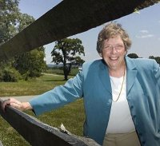
Ag & FS Updates
Ginger Myers retiring June 30
Regional Extension Marketing Specialist since 2007
Ag Marketing Program
Maryland Rural Enterprise Development Center
UME Beginning Farmer Success Program
Entrepreneurial Coaching for Ag Entrepreneurs and
Beginning Farmers
Initiated Maryland cheesemakers guild
LEAD Maryland Class II
Photo: UME

Slide 12


Ag & FS Updates
Congratulations AGNR Award Winners!
Sustainable Ag. Prod. Systems Cornerstone Award: (MARBIDCO)
Sustainable Ag. Prod. Systems Cornerstone Award: ANMP
Notes:
Maryland Agricultural & Resource Based-Industry Development Corporation

Slide 13
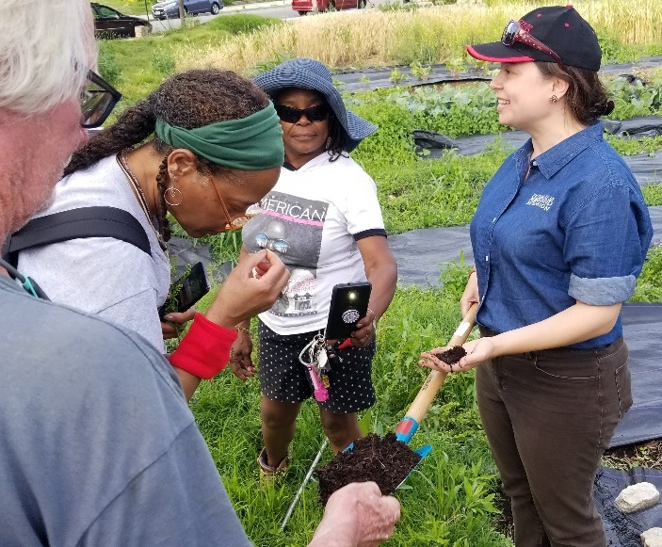
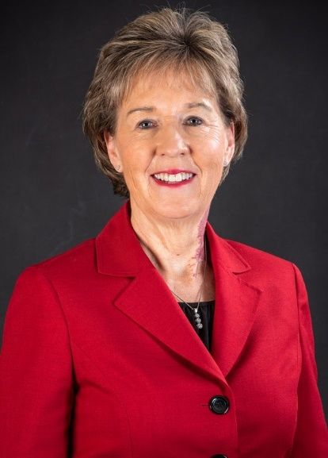
Ag & FS Updates
Congratulations AGNR Award Winners!
Off-Campus Junior Faculty Award: Neith Little
UME Extension Excellence Award: Jenny Rhodes
Photo: Darren Jarboe
Photo: Edwin Remsberg
Notes:
https://ansc-old.seed.umd.edu/news/dr-burk-elected-chair-board-national-association-equine-affiliated-academics-naeaa

Slide 14
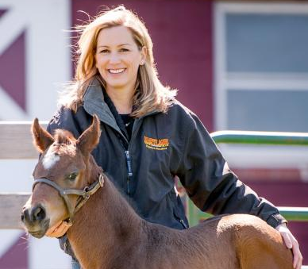
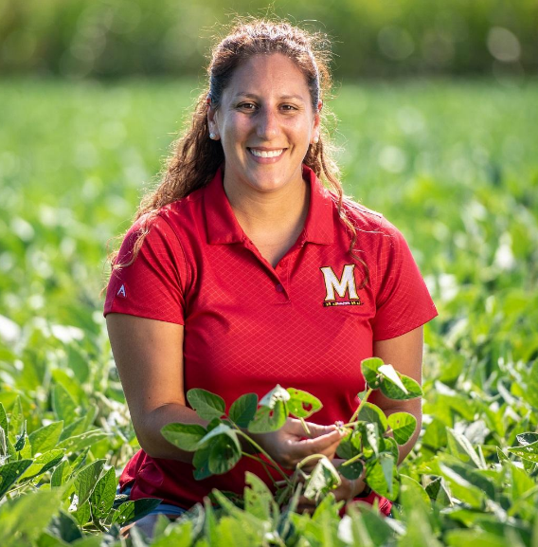
Ag & FS Updates
Congratulations AGNR Award Winners!
Integrated Research and Extension Excellence Award: Amy Burk
Dean’s Grantsmanship Award:
Nicole Fiorellino
Photo: Edwin Remsberg
Photo: Edwin Remsberg
Notes:
Off-Campus Staff Excellence Award: Susan Barnes
https://ansc-old.seed.umd.edu/news/dr-burk-elected-chair-board-national-association-equine-affiliated-academics-naeaa

Slide 15
Ag & FS Updates
Creating Leadership and Professional Development
Through Extension Internships
Shannon Dill, Nicole Fiorellino, Sarah Potts, and Alan Leslie
USDA-AFRI, $499,855
Seven summer interns annually
Students from community colleges, underserved and non-land-grant schools
Experiential learning in Extension and agricultural research
Develop UME hiring and mentorship skills
Increase students from these institutions entering the agricultural workforce

Slide 16
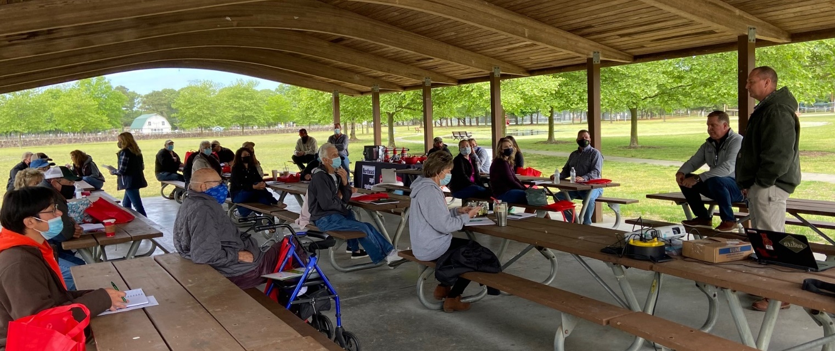
Ag & FS Updates
In-person Cool Cell Pad Maintenance Workshop
Sponsored by Northeast Ag, Jones Hamilton, and Munters
Photo: Jon Moyle
Notes:
Jon Moyle, Jenny Rhodes, Maegan Perdue, and Sheila Oscar
Sponsored by Northeast Ag, Jones Hamilton, and Munters

Slide 17
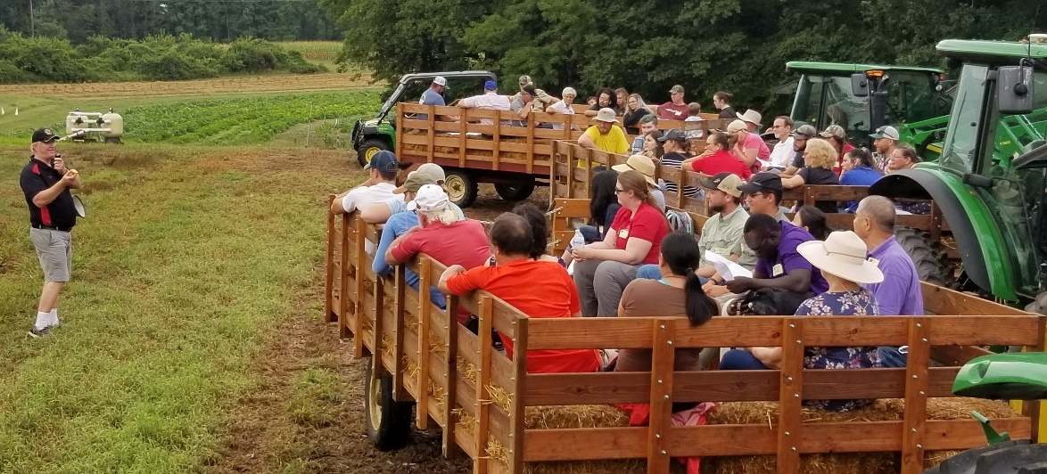
Ag & FS Updates
Upcoming AgFS In-person Programs
Advanced Ornamental Horticulture IPM Conference, Westminster, June 3
Greenhouse Growers Conference, Keymar, July 8
Dairy Field Day, CEMREC-Clarksville, July 13
Crops Twilight Barbecue & Ice Cream Social, Upper Marlboro, August 4
Photo: Darren Jarboe

Slide 18
Ag & FS Updates
Upcoming AgFS Online Programs
MidAtlantic Women In Agriculture Wednesday Webinar
  Health Insurance Options for Farmers, May 26
  Tips for Successful Family Meetings, June 9
  Forage Sampling and Forage Analysis Interpretation, June 23
Ornamental Horticulture IPM Scout Training, June 2, 9, 16, and 24
Eastern Shore Procrastinators Pesticide Conference, June 8

Slide 19

Ag & FS Updates
Newsletters Extend AgFS Program Reach

Slide 20
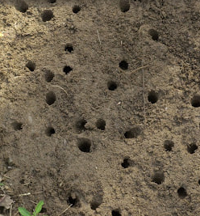
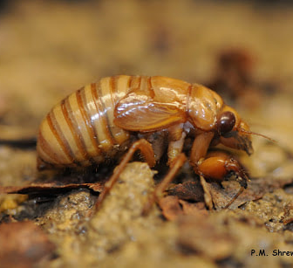
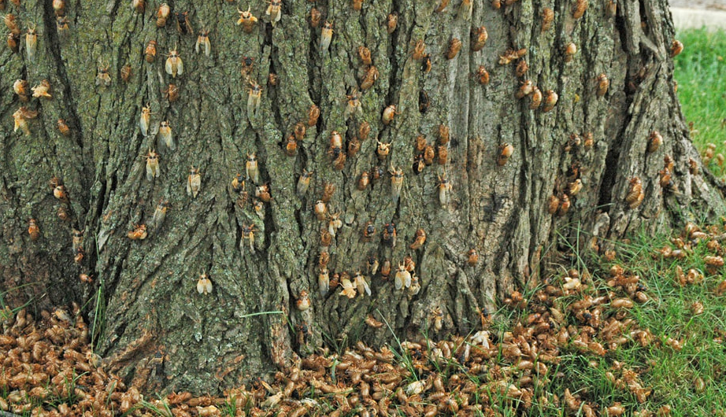
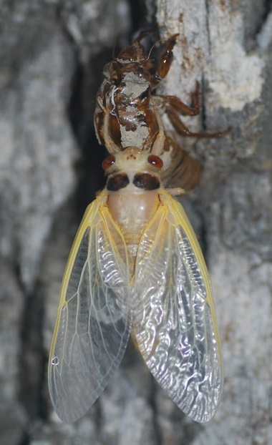
Ag & FS Updates
Brood X Periodical Cicadas
Brood X is emerging
Cicada Crew programs are popular (https://cicadacrewumd.weebly.com/)
Photos: Mike Raupp and Paula Shrewsbury

Slide 21
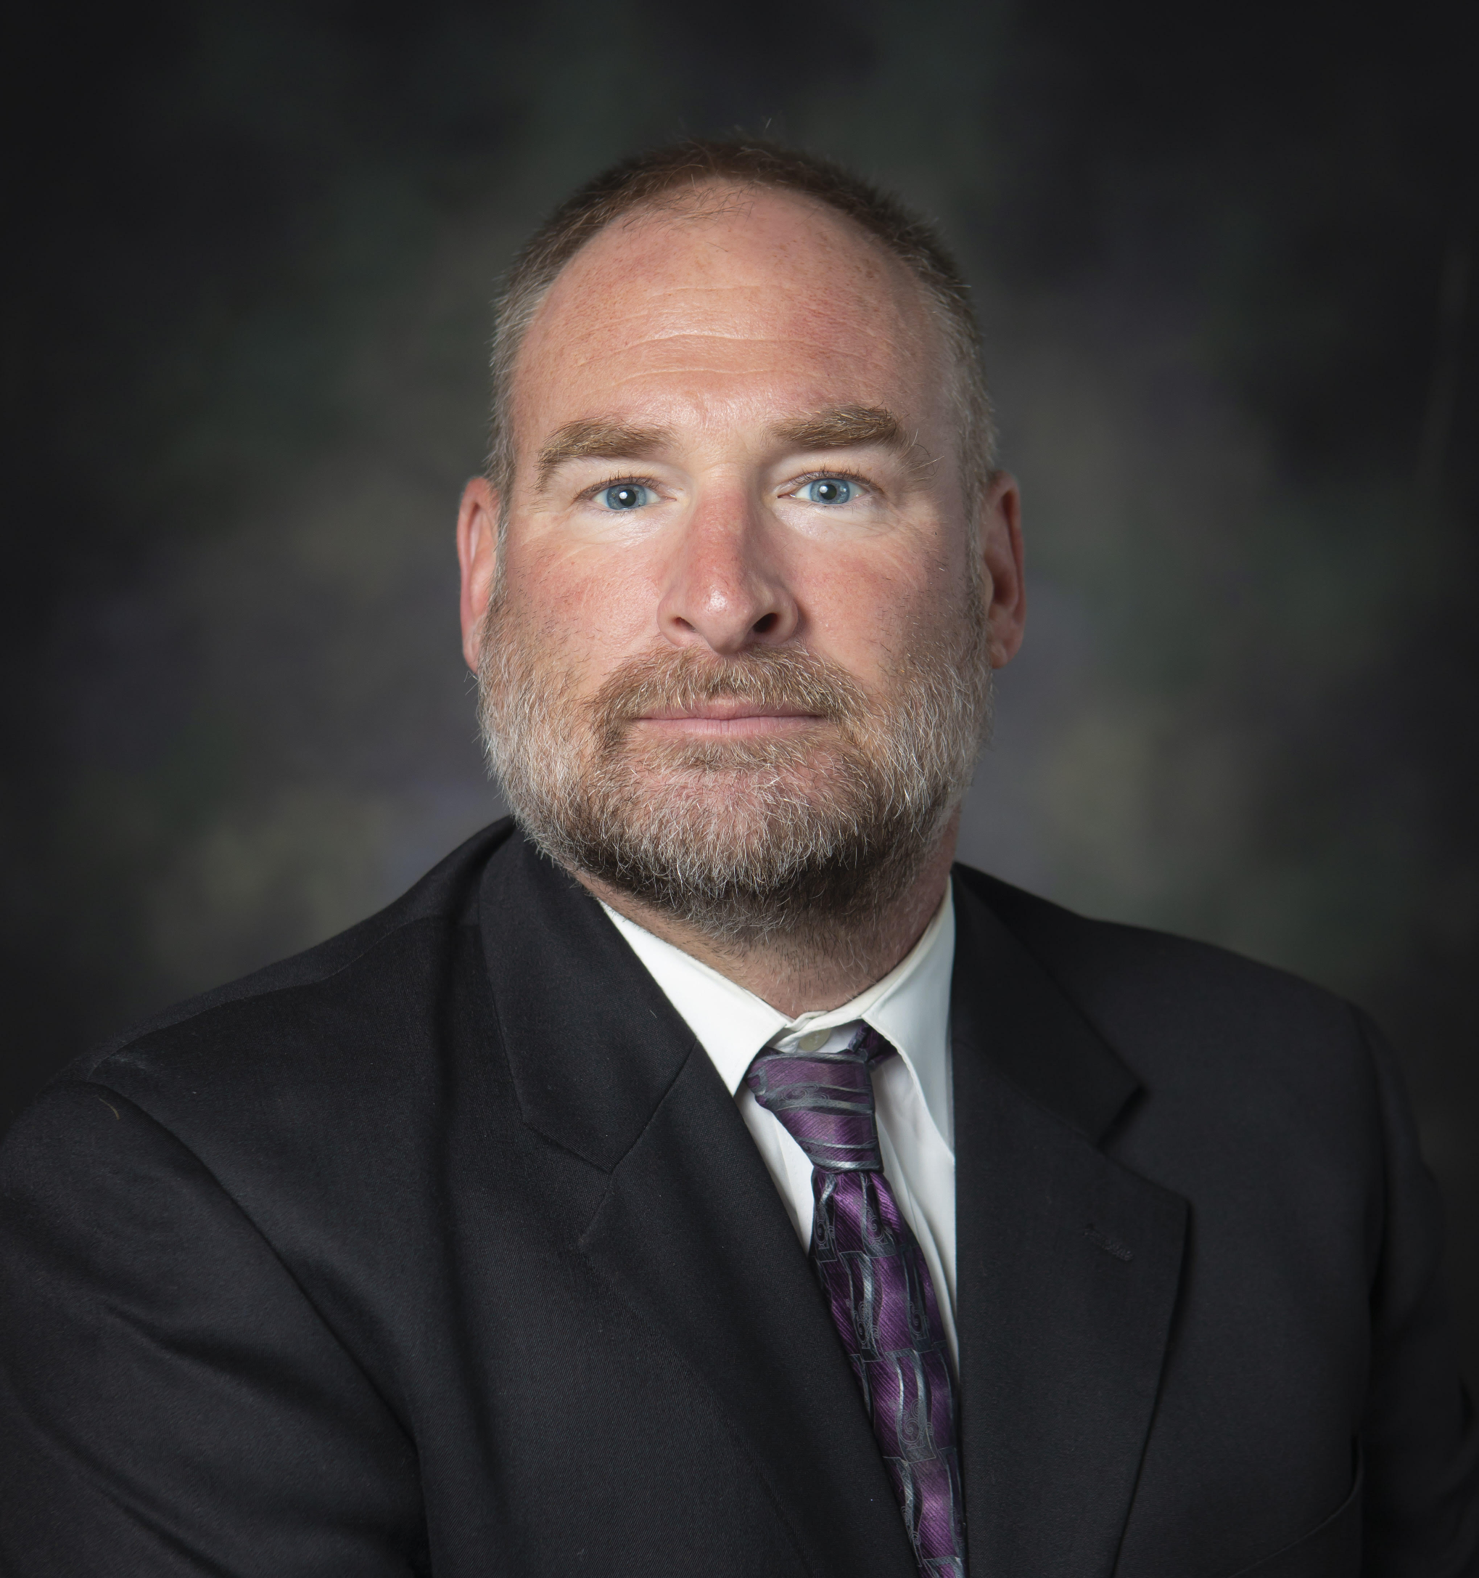
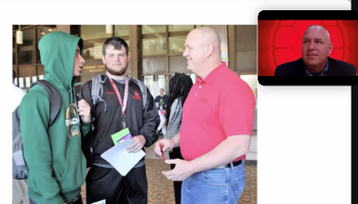
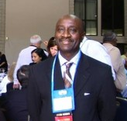
FCS Updates
New FCS Educator
Michael Bievenour, Financial Educator in Worcester County Office mbieveno@umd.edu
Awards
Jesse Ketterman
Community Champion Award in the Financial Education and Capability Awards Program
Michael Elonge
AGNR Diversity, Equity, Inclusion, and Respect Faculty Award
Notes:
Michael Bievenour is the Financial Educator in the Worcester County Office. He comes to us after working in the Public School System for 28 years. During that time he had taught Technology Education in High School for 13 years and was an Assistant Principal for 15 years working at all levels PK through 12. He also brings to us experience teaching adults through teaching public school teachers as well as teaching at his local Community College and Universities. His educational experience is that attended California University of Pennsylvania (BS) and Ball State University (MA) earning both degrees in Technology Education. Mike currently resides in Wicomico County with his wife Ronna who is a teacher and has two children Carsten who is working and Klaira who is attending college. Please feel free to reach out to Michael mbieveno@umd.edu
Jesse Ketterman by CASH Campaign of Maryland, Maryland Council on Economic Education, and the Maryland State Department of Education
Michael Elonge, AGNR Diversity, Equity, Inclusion, and Respect Faculty Award

Slide 22

FCS Updates
Mental Health Awareness Month
Delmarva Farmer
UMDExtension Facebook
University of Maryland Extension YouTube Channel
Farm Stress Management and the FCS Mental Health and Well-Being
Notes:
Shannon Dill initiated a month-long series of articles with the Delmarva Farmer and Sean Clougherty has been publishing one article a week. Articles have been written by Shannon and Bonnie Braun, Jeanette Jeffrey, Emily Zobel, and Jesse Ketterman.
Videos have been produced by Dhruti Patel, Erin Jewell, Amy Rhodes, and Alex Chan. They can all be found on our YouTube channel.
We are featuring all of this work in slideshows on the Farm Stress Management and the FCS Mental Health and Well-Being webpages, as well as through our social media platforms.

Slide 23
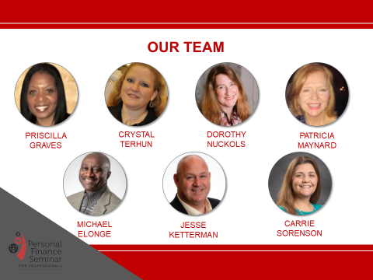
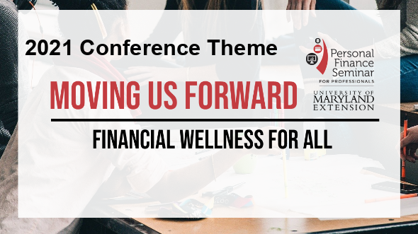
FCS Updates

Slide 24
FCS Updates
Grants
USDA-CYFAR Sustainable Community Project
Title: Addressing Youth Mental Health of Latinx Families by Strengthening Family-Skills and Engaging in Sports
Period: 09/30/21-09/29/2026 Budget: $528,884
Ali Hurtado Choque, Alex Chan, and Jamie Morris
Close Encounters with Agriculture program from Maryland Grain Producers Utilization Board
Mona Habibi and Montgomery County Team, $6,000

Slide 25


FCS Updates
UME Vaccine Education
https://extension.umd.edu/covid-19-vaccine-education

Slide 26
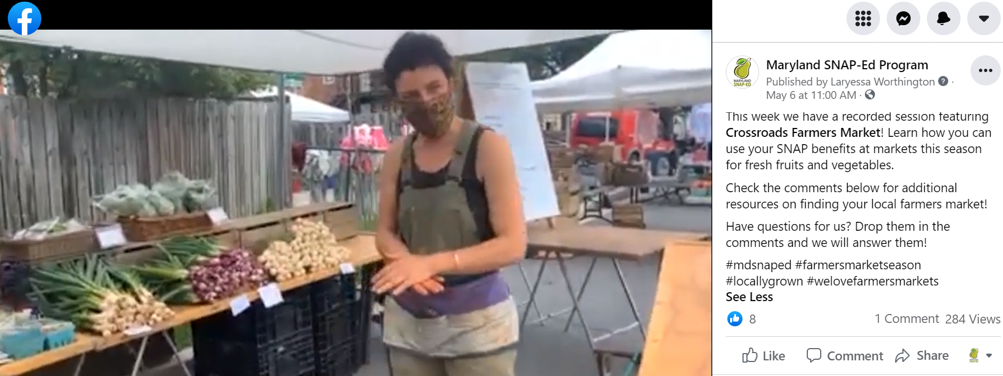
FCS Updates
SNAP-Ed's award-winning Facebook live series pivoted to Fresh from Maryland, focusing on accessing, selecting, and preparing local foods.
  Episodes feature seasonal produce items, recipe demos led by SNAP-Ed, tips for using benefits (SNAP, WIC, P-EBT) to access local produce. Special guests include Crossroads Farmers' Market, Cambridge Community Garden, Maryland WIC, the Roving Radish, and UME's own Shauna Henley! Featured on P-EBT, No Kid Hungry reached over 8,100 people.
Montgomery County EFNEP/SNAP-Ed Farmer Market education partnership shared class time with 8 sessions to explain utilizations at farmers markets

Slide 27
FCS Updates
EFNEP Two AFRI Proposals Submitted:
1. Drs. Ali Hurtado (UME/SPH), Mira Mehta and Kavitha Sankavaram (NFSC/EFNEP/UME) are CoPIs on the proposal, Diet, Nutrition and Chronic Disease Prevention AFRI titled, Increasing the Reach and Graduation Rates of Nutrition Education Utilizing a Blended Mobile Health Component”
2. A Multistate Project, A Cost-Benefit Analysis of EFNEP Utilizing Biomarkers of Chronic Disease Risk. Dr. Sankavaram is CoPI on this research proposal

Slide 28
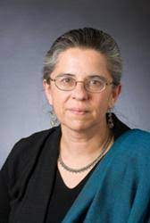
FCS Updates
EFNEP educators Carmenletta Fletcher (PG) and Elizabeth Saunders (Montgomery) will be presenting a workshop for EFNEP educators across the Northeast Region titled, “Cooking in a Virtual World: Best Practices to Engage and Empower Youth Audiences towards a Healthy Lifestyle”. The workshop was presented earlier this year at the National EFNEP Conference to USDA/NIFA administrators, EFNEP Directors, and EFNEP specialists across the Nation.
AGNR On-Campus Professional Track Faculty Award: Dr. Mira Mehta

Slide 29

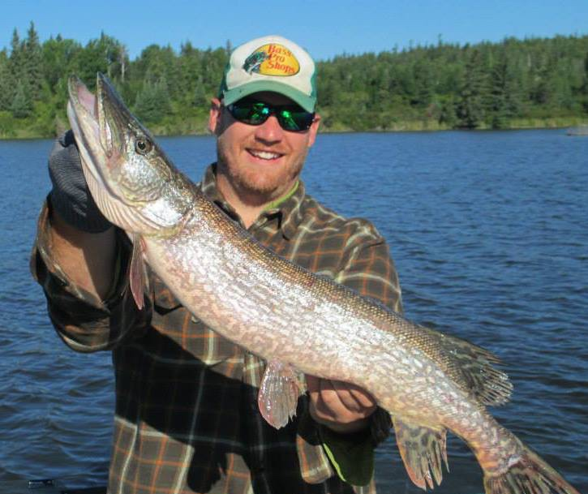
ENR & SG Updates
Personnel Updates
Retirement
  Nancy Stewart, Natural Resources Educator, UMD Wye Research & Education Center
USDA Funded Shellfish Technologies Extension Specialist
  Dr. D. Allen Pattillo, UMD Wye Research & Education Center

Slide 30
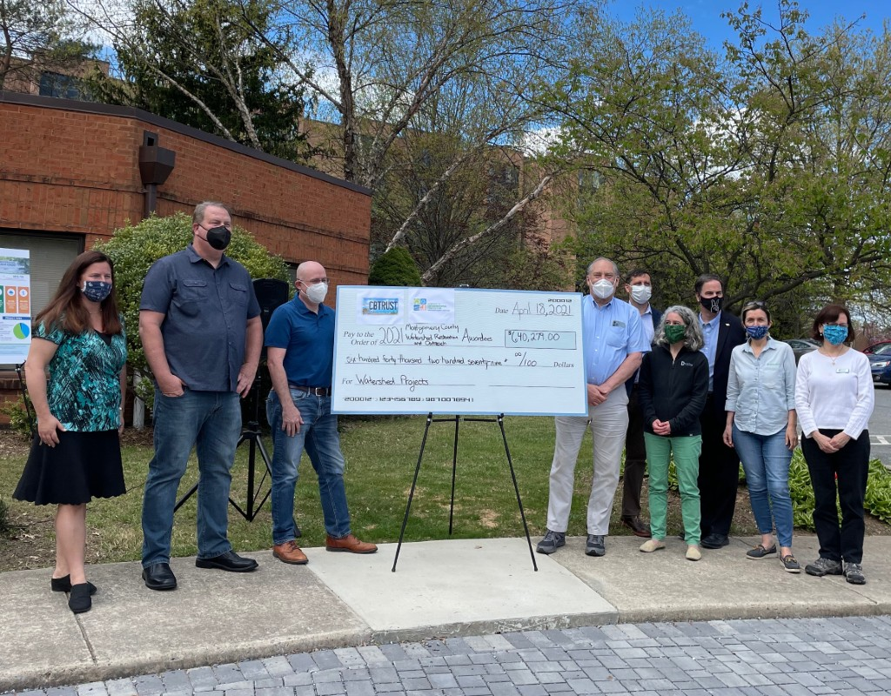
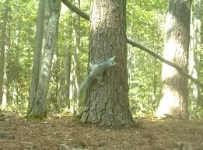
ENR & SG Updates
New Resources – New Programs
Amanda Rockler, “A Green Infrastructure Plan for Glenwood Recreation Center - Silver Spring, MD” – CBT, $20,000.
Luke Macaulay, Agnes Kedmenecz, Jonathan Kays, Bill Hubbard, “Delmarva Woodland Stewards for Wildlife, Wildfire, Water, and Wood” - Maryland Forest Service/USDA FS, $87,000.

Slide 31
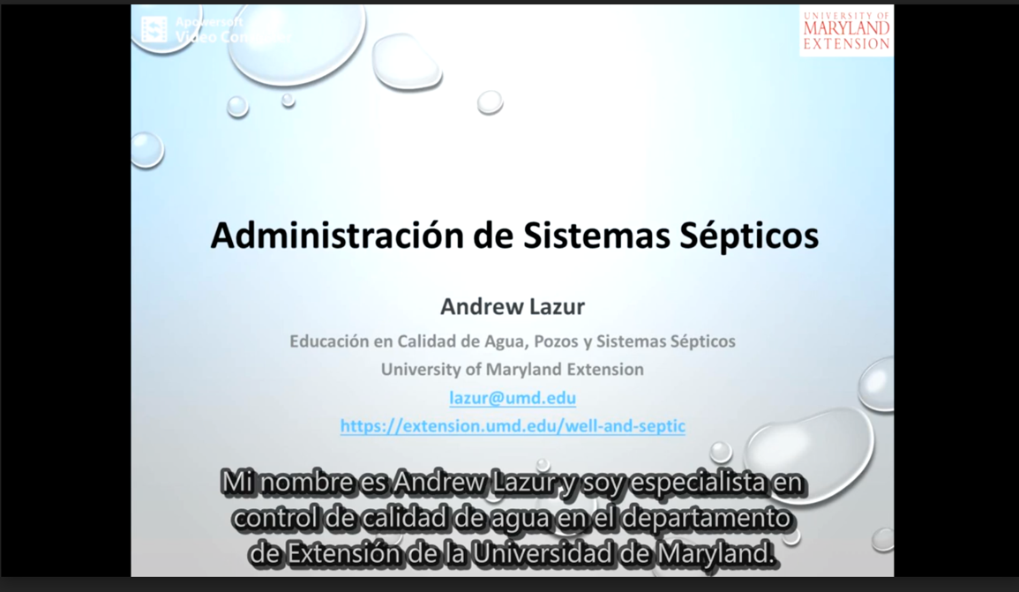
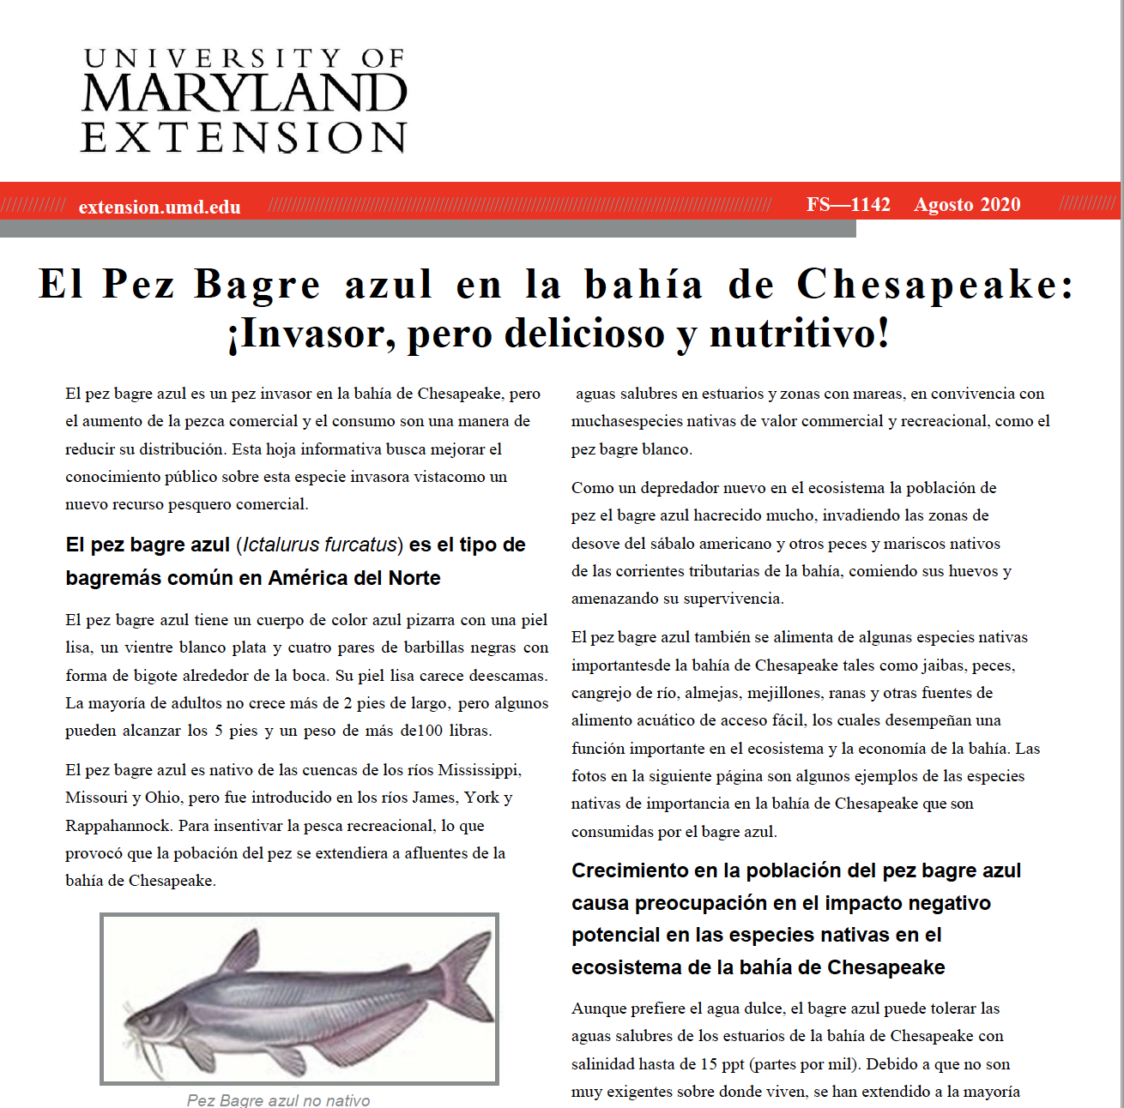

ENR & SG Updates
Diversity, Equity and Inclusion Spotlight
Conversion materials to Spanish (fact sheets, videos, blog posts) by Andy Lazur, Cathy Liu and Eric Buehl)

Slide 32

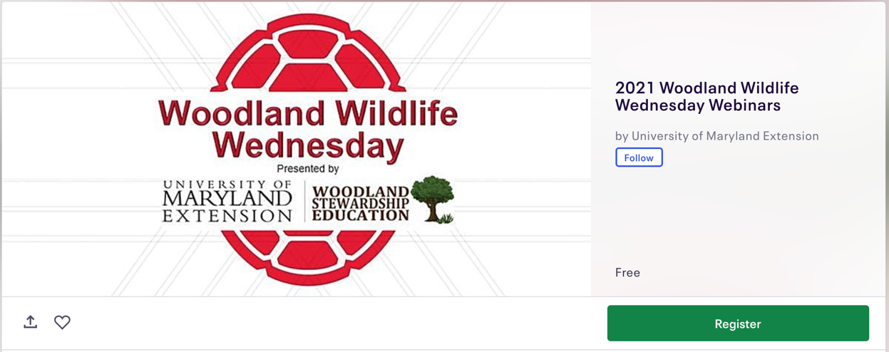
ENR & SG Updates
Programmatic Updates
Garden Thyme Podcast Updates (Emily Zobel, Rachel Rhodes, Mikaela Boley)
  National Finalist for the NACAA 2021 Audio Recording Communication Award
  https://gardenthymepodcast.buzzsprout.com/687509
Woodland Wildlife Wednesday
  Bats, Bat Research and Conservation in Maryland – June 16th, 12-1 pm Eastern)
  https://extension.umd.edu/resource/woodland -wildlife-wednesday-webinar-series

Slide 33
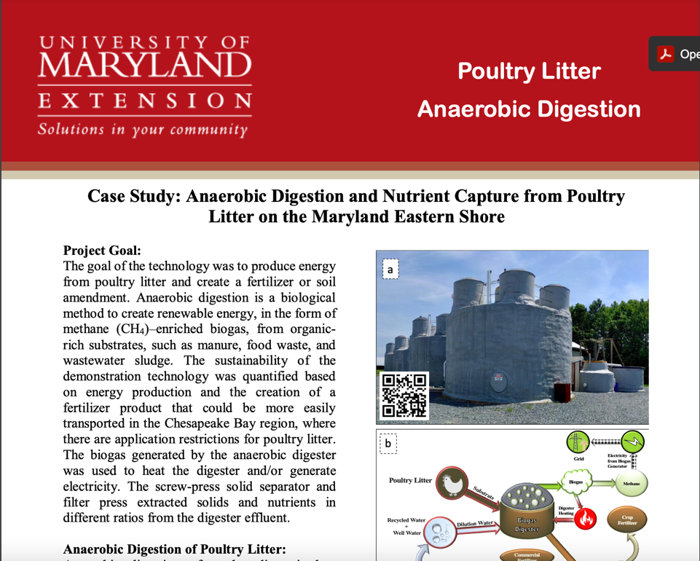
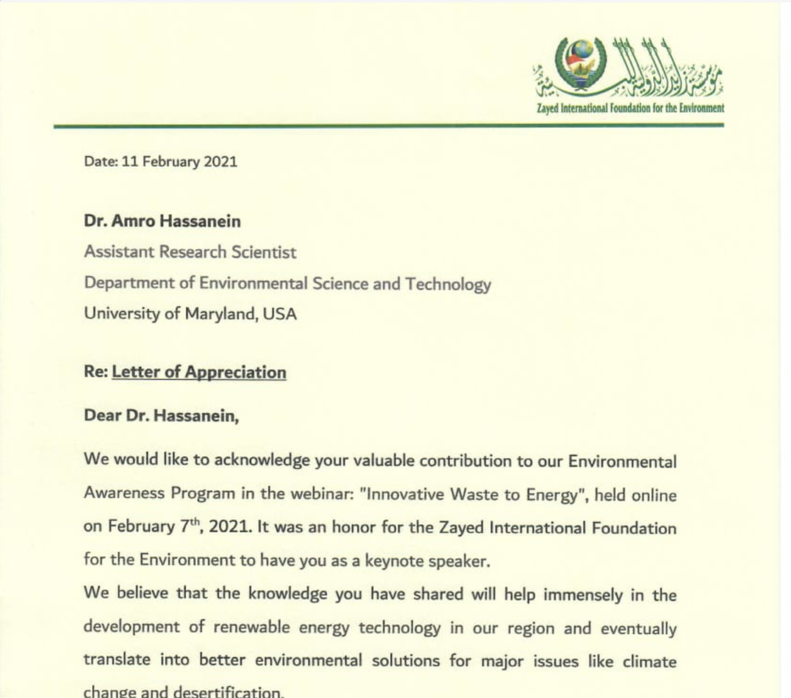
ENR & SG Updates
Programmatic Updates
Waste to Energy (Amro Hassanein)
  New materials, initiatives, funding to help farmers and others understand how to turn organic waste to energy
  Internationally recognized for his work and presentations on “Innovative Waste to Energy”.

Slide 34


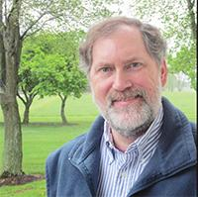
ENR & SG Updates
Programmatic Updates
ANREP Annual Awards Program
  Woodland Health Practices Handbook – Team included Jonathan Kays and Agnes Kedmenecz (Bronze Award, Long Publication).
Biannual meeting – May 24-26, 2021
  Virtual – visit anrep.org.
Congratulations again to Andrew Kling, Natural Resources Educator for AGNR Off-Campus Faculty Award!

Slide 35
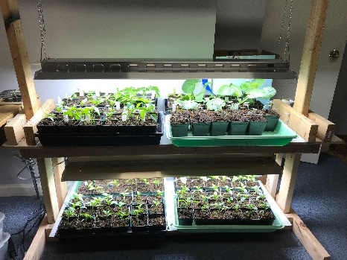
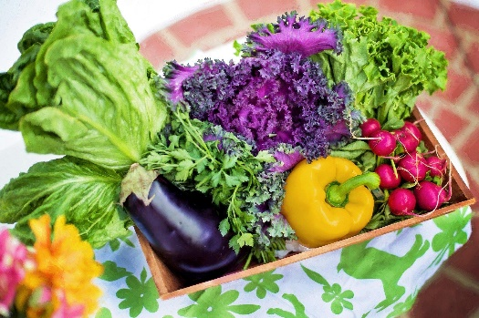
ENR & SG Updates
Programmatic Updates
Seed Starting Workshop Series (Jon Traunfeld and Courtney Coddington)
  Participants were mailed seed packets
  3 workshops, 3 interactive sessions
  Excellent reviews – 30% increase in confidence
Hybrid Master Gardener Basic Training
  90 graduates completed the Spring Basic Training Course Online and with some limited face time.
HGIC Update
  Answered 6100 questions from Jan-May 2021
  7 campus-based faculty and 13 Master Gardener Coordinators assisted

Slide 36
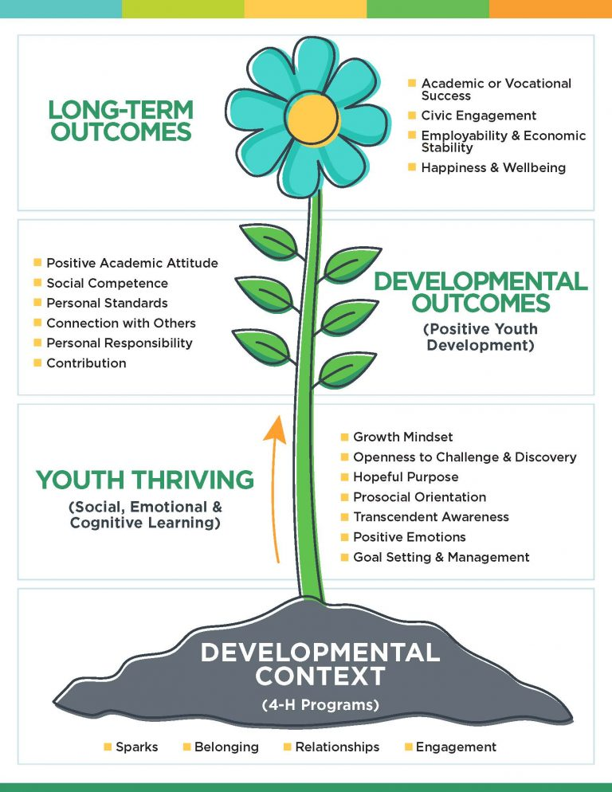
4-H Updates
The Science of Positive Youth Development (PYD)
4-H creates the context and content for positive youth development, subscribing to a set of essential elements characteristic of high quality youth development.
4-H values results-driven educational opportunities and experiences that are based upon cutting edge youth development research and best practices to have impact.

Slide 37
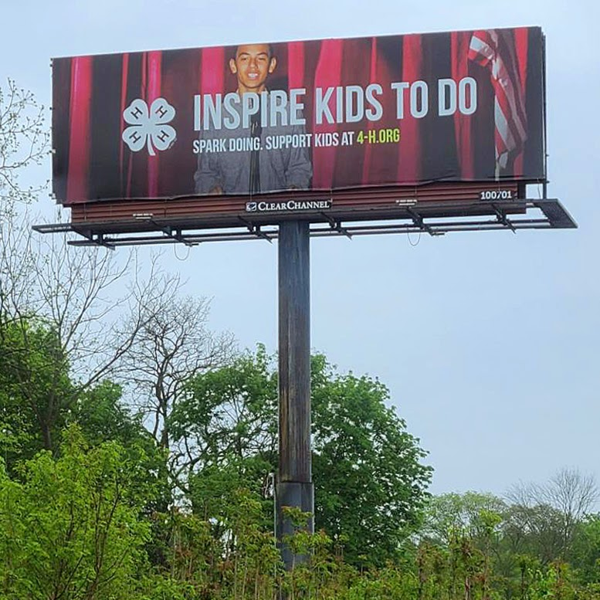
4-H Updates
Brand Marketing
Maryland 4-H continues to increase our visibility across our state! Check out the latest billboard in Hagerstown.

Slide 38
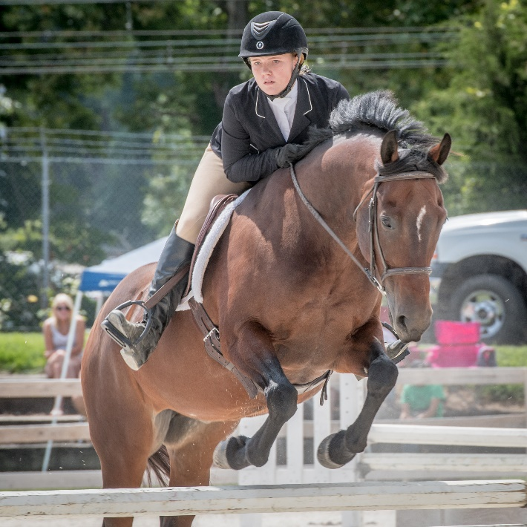
4-H Updates
Upcoming Events:
  Hippology and Horse Judging- June 12th
  Livestock Skillathon- June 19th
  Teen Leadership Summit- June 28th

Slide 39
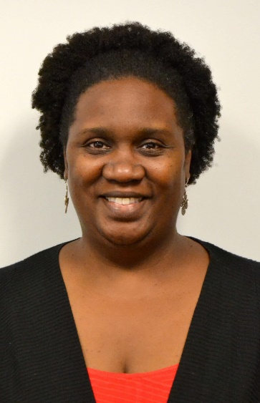
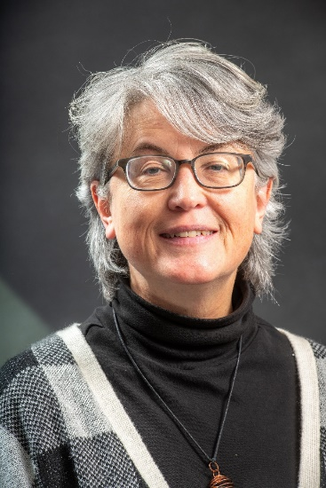
Kudos- AGNR 2021 Awards
4-H Updates
Vernelle Mitchell-Hawkins- AGNR Cornerstone Optimize Urban Environments
Trish Moore-
On-Campus Staff Excellence Award
Bonnie Boyden-
Off-Campus Staff Excellence Award

Slide 40
Q&A

Slide 41
Thank you for attending

